Slide 1
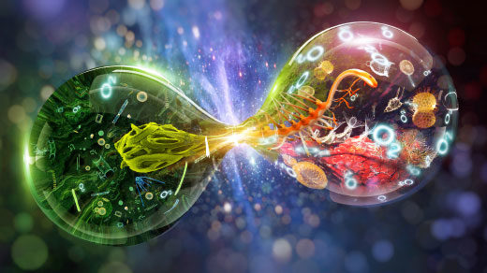

BIOLOGY 1010
Unit 5.1 Cell Signaling
This work is licensed under a Creative Commons Attribution-NonCommercial-ShareAlike 4.0 International License.

Slide 2
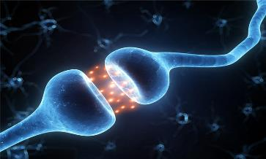
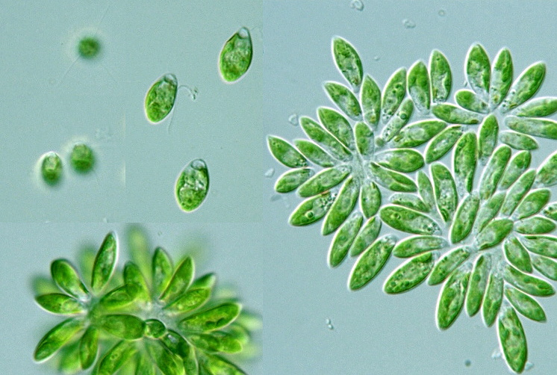
The plasma membrane plays a key role in most cell signaling
In multicellular organisms, cell-to-cell communication allows the cells of the body to coordinate their activities
Communication between cells is also essential for many unicellular organisms
© 2014 Pearson Education, Inc.
Notes:
*

Slide 3
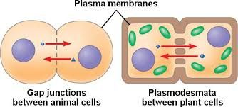
Local and Long-Distance Signaling
Eukaryotic cells may communicate by direct contact
Animal and plant cells have junctions that directly connect the cytoplasm of adjacent cells
These are called gap junctions (animal cells) and plasmodesmata (plant cells)
The free passage of substances in the cytosol from one cell to another is a type of local signaling
© 2014 Pearson Education, Inc.
Notes:
*

Slide 4
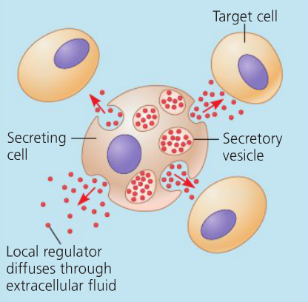
In many other cases of local signaling, messenger molecules are secreted by a signaling cell
These messenger molecules, called local regulators, travel only short distances
One class of these, growth factors, stimulates nearby cells to grow and divide
This type of local signaling in animal cells is called paracrine signaling
© 2014 Pearson Education, Inc.
Notes:
*

Slide 5
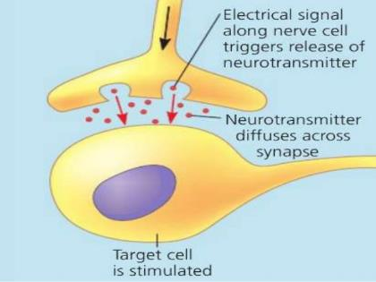
Another more specialized type of local signaling occurs in the animal nervous system
This synaptic signaling consists of an electrical signal moving along a nerve cell that triggers secretion of neurotransmitter molecules
These diffuse across the space between the nerve cell and its target, triggering a response in the target cell
© 2014 Pearson Education, Inc.
Notes:
*

Slide 6
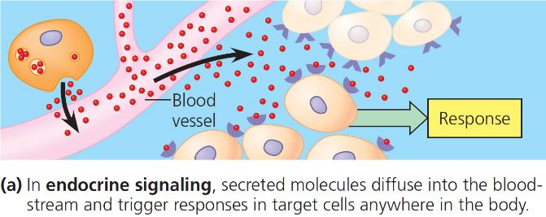
In long-distance signaling, plants and animals use chemicals called hormones
Hormonal signaling in animals, called endocrine signaling, specialized cells release hormone molecules that travel via the circulatory system
Hormones vary widely in size and shape
© 2014 Pearson Education, Inc.
Notes:
*

Slide 7
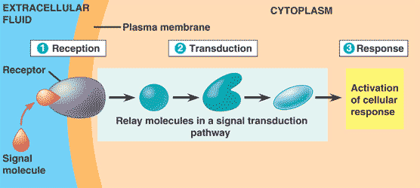
The Three Stages of Cell Signaling
Earl W. Sutherland discovered how the hormone epinephrine acts on cells
Sutherland suggested that cells receiving signals undergo three processes
  Reception
  Transduction
  Response
© 2014 Pearson Education, Inc.
Notes:
*

Slide 8
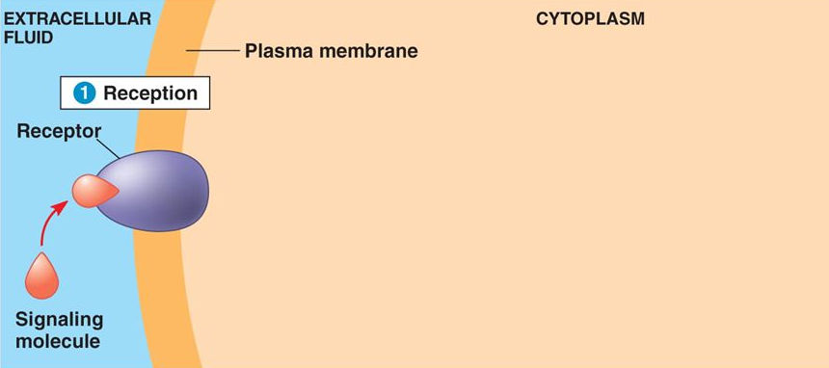
Reception, the Binding of a Signaling Molecule to a Receptor Protein
The binding between a signal molecule (ligand) and receptor is highly specific
Ligand binding generally causes a shape change in the receptor
Many receptors are directly activated by this shape change
Most signal receptors are plasma membrane proteins
© 2014 Pearson Education, Inc.
Notes:
*

Slide 9
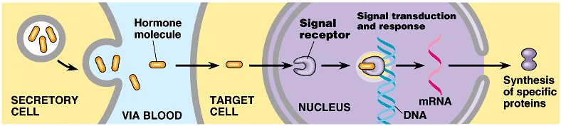
Intracellular Receptors
Intracellular receptor proteins are found in the cytosol or nucleus of target cells
Hydrophobic chemical messengers can cross the membrane and activate receptors
  Examples of hydrophobic messengers are the steroid and thyroid hormones of animals and nitric oxide (NO) in both plants and animals
© 2014 Pearson Education, Inc.
Notes:
*

Slide 10
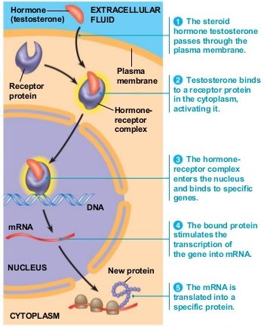
Testosterone behaves similarly to other steroid hormones
Only cells that contain receptors for testosterone can respond to it
The hormone binds the receptor protein and activates it
The active form of the receptor enters the nucleus, acts as a transcription factor, and activates genes needed for male sex characteristics
© 2014 Pearson Education, Inc.
Notes:
*

Slide 11
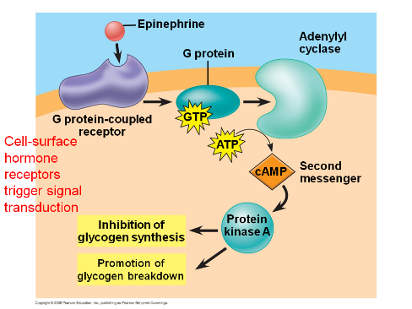
Transduction by Cascades of Molecular Interactions
Signal transduction usually involves multiple steps
Multistep pathways can amplify a signal: A few molecules can produce a large cellular response
Multistep pathways provide more opportunities for coordination and regulation of the cellular response than simpler systems do
© 2014 Pearson Education, Inc.
Notes:
*

Slide 12
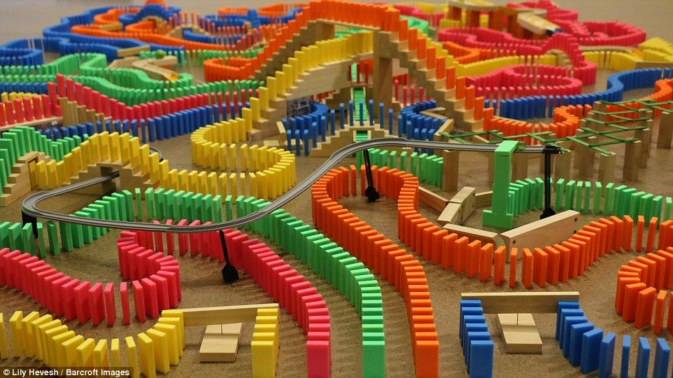
The molecules that relay a signal from receptor to response are mostly proteins
Like falling dominoes, the receptor activates another protein, which activates another, and so on, until the protein producing the response is activated
At each step, the signal is transduced into a different form, usually a shape change in a protein
© 2014 Pearson Education, Inc.
Notes:
*

Slide 13
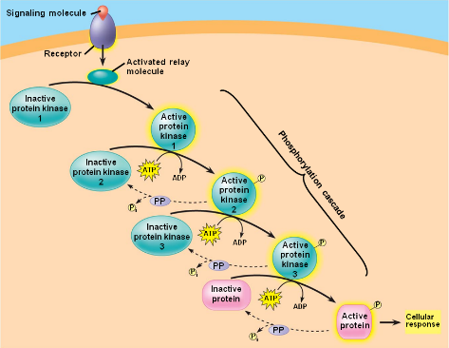
Protein Phosphorylation and Dephosphorylation
Phosphorylation and dephosphorylation are a widespread cellular mechanism for regulating protein activity
Protein kinases transfer phosphates from ATP to protein, a process called phosphorylation
  The addition of phosphate groups often changes the form of a protein from inactive to active
Protein phosphatases remove the phosphates from proteins, called dephosphorylation
  Phosphatases provide a mechanism for turning off the signal transduction pathway
  They also make protein kinases available for reuse, enabling the cell to respond to the signal again
Notes:
*

Slide 14
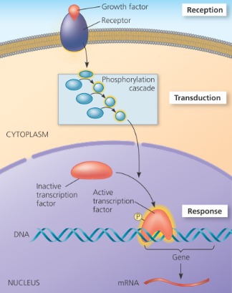
Response: Regulation of Transcription or Cytoplasmic Activities
Ultimately, a signal transduction pathway leads to regulation of one or more cellular activities
The response may occur in the cytoplasm or in the nucleus
Many signaling pathways regulate the synthesis of enzymes or other proteins, usually by turning genes on or off in the nucleus
The final activated molecule in the signaling pathway may function as a transcription factor
© 2014 Pearson Education, Inc.
Notes:
*

Slide 15
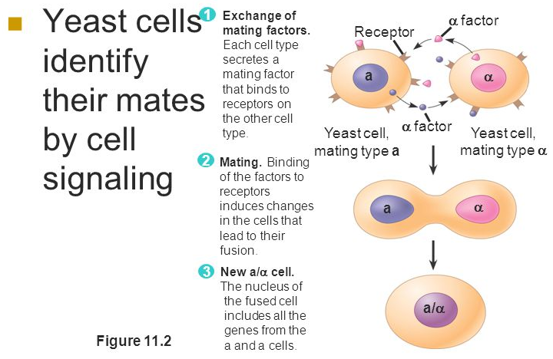
The Evolution of Cell Signaling
Biologists have discovered some universal mechanisms of cellular regulation, evidence of the evolutionary relatedness of all life
Scientists think that signaling mechanisms first evolved in ancient prokaryotes and single-celled eukaryotes
These mechanisms were adopted for new uses in their multicellular descendants
© 2014 Pearson Education, Inc.
Notes:
*

