Slide 1
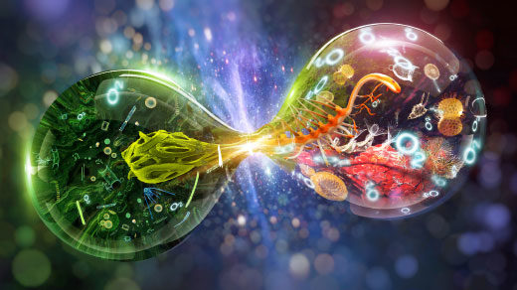

BIOLOGY 1010
Unit 1.2 The Building Blocks of Molecules
This work is licensed under a Creative Commons Attribution-NonCommercial-ShareAlike 4.0 International License.

Slide 2
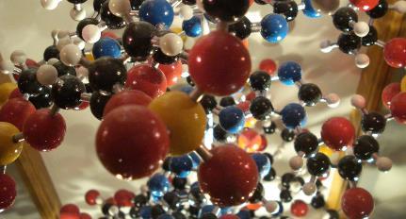
Atoms are the Building
Blocks of Molecules
Life is composed of matter
Matter:
  occupies space
  has mass
Elements are unique forms of matter
  Specific chemical properties
  Specific physical properties

Slide 3
Elements and the Living World
Elements cannot be broken down into smaller substances
Each element is designated by a chemical symbol (one or two letters)
  Sulfur = S
  Calcium = Ca
Four most common elements of living organisms
  Carbon C
  Oxygen = O
  Hydrogen = H
  Nitrogen = N
Element | Life (Humans) | Atmosphere | Earth’s Crust
Oxygen (O) | 65% | 21% | 46%
Carbon (C) | 18% | trace | trace
Hydrogen (H) | 10% | trace | 0.1%
Nitrogen (N) | 3% | 78% | trace

Slide 4
Atoms are the Building Blocks of Elements
Atom – smallest unit of matter that retains all chemical properties of an element. Atoms contains two regions
  Nucleus – center of the atom and contains protons and neutrons
  Outermost region – holds electrons in orbit around the nucleus
Protons, neutrons, and electrons are referred to as sub-atomic particles
 | Charge | Mass | Location
Proton | +1 | 1 | nucleus
Neutron | 0 | 1 | nucleus
Electron | -1 | 0 | orbitals

Slide 5
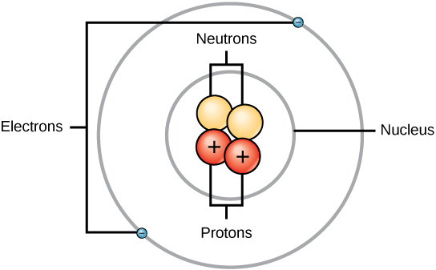
The Arrangement of Sub-Atomic Particles
Example of an atom from the element Helium (He)
Simplified depiction of how sub-atomic particles are arranged within an atom.

Slide 6
What’s the difference between
Atomic number and Atomic mass?
Atoms of each element have a standard number of protons and electrons
Atomic Number is the number of protons
  Each element has a distinct atomic number
Atomic Mass is the mass of the atom, roughly equal to number of protons and neutrons
  The number of neutrons can vary in an element
  Elements with different number of neutrons are isotopes
  Electrons don’t need to be included in calculation of atomic mass
  Atomic mass is expressed in atomic mass units (amu)
We can calculate the number of neutrons in an element by subtracting the atomic number from the atomic mass

Slide 7
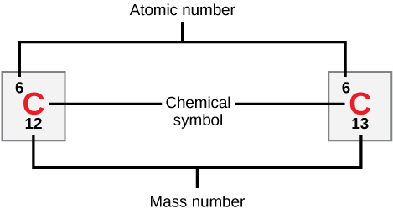
Atomic mass vs. atomic number
Carbon has an atomic number of six, and two stable isotopes with mass numbers of twelve and thirteen, respectively. Carbon-12’s atomic mass is approx. 12.11.

Slide 8
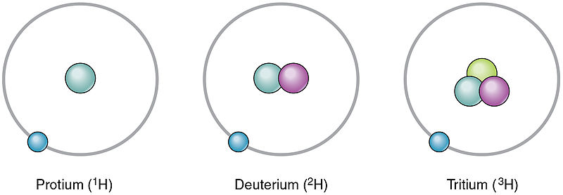
Isotopes
Forms of an element with different numbers of neutrons, and thus different mass numbers
Example:
¹H has 0 neutrons
²H has 1 neutron
³H has 2 neutrons

Slide 9
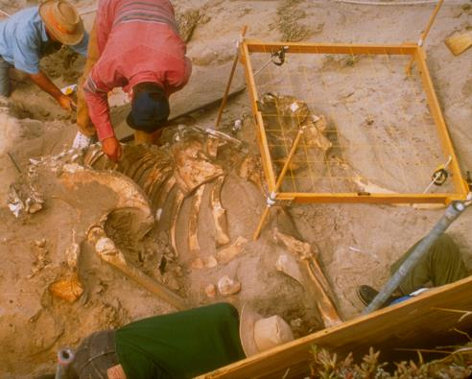
Isotopes can be used as a research tool
Radioisotopes – isotopes that emit neutrons, protons, and electrons
Radiometric dating takes advantage of this natural phenomenon
Example: Over time Carbon-14 decays to Nitrogen-14. Researchers can compare Carbon-14 in atmosphere to carbon-14 in fossils remains and estimate fossil age
The age of carbon-containing remains less than about 50,000 years old, such as this pygmy mammoth, can be determined using carbon dating.
For older objects, scientists analyze the presence of isotopes of uranium (which decays to lead), potassium, or rubidium.

Slide 10
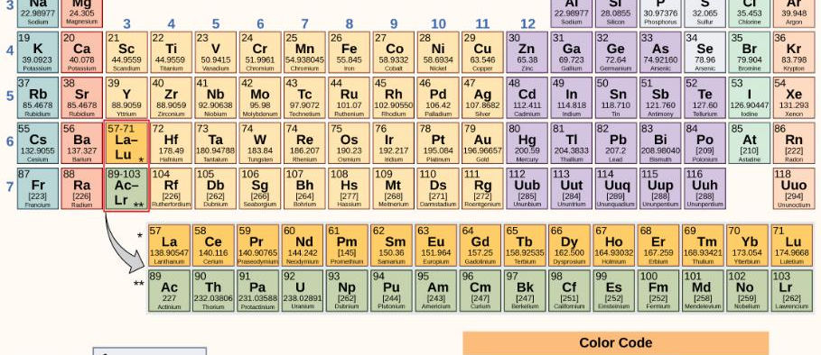
Periodic Table
The periodic table shows the atomic mass and atomic number of each element. The atomic number appears above the symbol for the element and the approximate atomic mass appears below it.

Slide 11
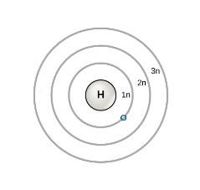
Electron Shells and the Bohr Model
Atoms with neutral charge
  Number of protons = number of electrons
  Number of electrons = atomic number
Bohr model – early model with protons in nucleus and electrons in circular orbits at specific distance from nucleus
Orbits: electron shells or energy levels
An electron normally exists in the lowest available energy shell (closest to the nucleus)
Electrons fill orbitals closest to nucleus first, then those further away in order (i.e. 1n fills first, then 2n, then 3n, etc.)

Slide 12
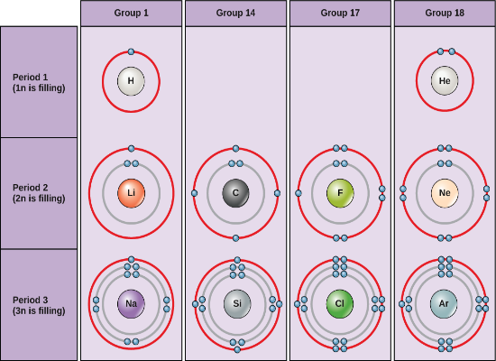
Electrons filling their shells
Outer shell: Valence shell
The most stable configuration occurs when the valence shell is filled
The elements in group 18 of this diagram have full valence shells
When the first two outer shells are filled each will have eight electrons (octet rule)
  Group 1 elements (H, Li, NA) could achieve stability by losing an outer electron
  Group 17 elements could achieve stability by gaining one additional electron

Slide 13
What about electron orbitals?
Bohr models are incomplete
Electrons are not in planet-like orbits
Electron orbitals – complex shapes that describe how electrons are spatially distributed around the nucleus
Quantum mechanics allows us to predict where an electron might be at any given time
This predicted area is known as the orbital

Slide 14
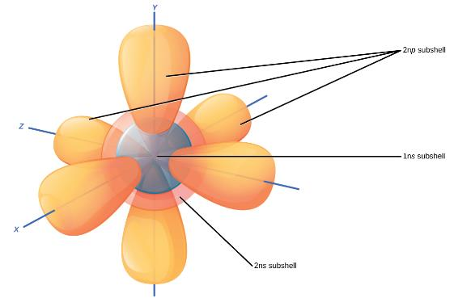
Subshells have unique shapes
Within each Bohr model shell are subshells
Each subshell (s,p,d,f) has a specified number of orbitals containing electrons
The s subshell is spherical and has one orbital
The p subshell is dumbbell shaped and has three orbitals
Electrons determine how atoms interact
Chemical reactions are changes in distribution of electrons between atoms
Notes:
The s subshells are shaped like spheres. Both the 1n and 2n principal shells have an s orbital, but the size of the sphere is larger in the 2n orbital. Each sphere is a single orbital. p subshells are made up of three dumbbell-shaped orbitals. Principal shell 2n has a p subshell, but shell 1 does not.

Slide 15
Chemical Reactions
Reactants – substances used at beginning of reaction
Products – substances formed at the end of the reaction
2H₂O₂ 2H₂O + O₂
Reactants Products

Slide 16
Chemical Reaction can be
Reversible or Irreversible
2H₂O₂ 2H₂O + O₂
Irreversible reaction: proceeds in one direction until all the reactants are used up
HCO₃⁻ + H⁺ H₂CO₃
Reversible reaction: Reactants are converted to products but some product can be converted back to reactant

Slide 17
How Do Atoms Bond to Form Molecules?
Chemical bond: the attractive force that links atoms together to form molecules
  Covalent Bonds
  Ionic bonds
  Hydrogen Bonds
  Van Der Waals Interactions

Slide 18
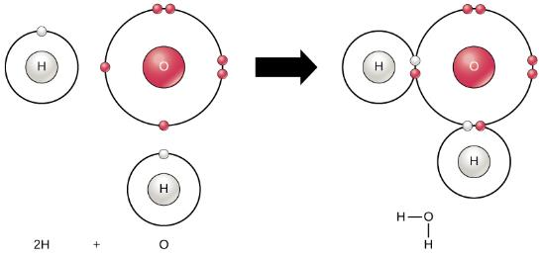
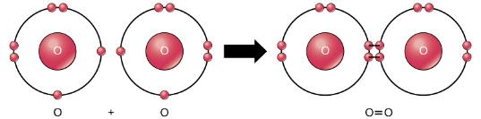
Covalent Bonds – Electrons are shared
Two or more atoms may bond with each other to form a molecule.
When two hydrogens and an oxygen share electrons via covalent bonds, a water molecule is formed.
More than one set of electrons can be shared
The oxygen atoms in an O₂ molecule are joined by a double bond.

Slide 19
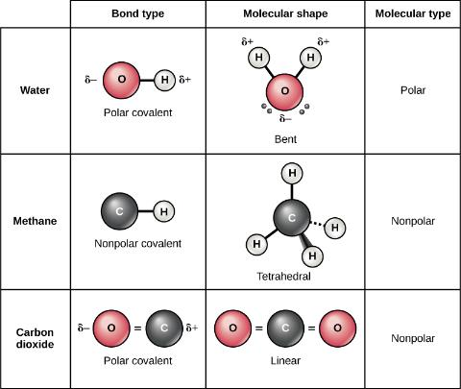
Polar Bonds - Covalent bonds in which there is unequal sharing of the electrons
Polar Covalent Bonds
Electrons are unequally shared by the atoms and attracted more to one nucleus than the other
Water is a great example
Oxygen has higher electronegativity than hydrogen
This means it wants the electrons more than than hydrogen does

Slide 20

Non-Polar Bonds–Covalent bonds in which there is equal sharing of the electrons
Non-Polar Covalent Bonds
Electrons are equally shared by the atoms
Methane (CH₄) is a great example
Carbon shares electrons with four hydrogens equally
Both bond type and molecular shape determine whether a molecule is polar or nonpolar
Why is carbon dioxide a nonpolar molecule even though the oxygen-carbon bond is a polar covalent bond?

Slide 21
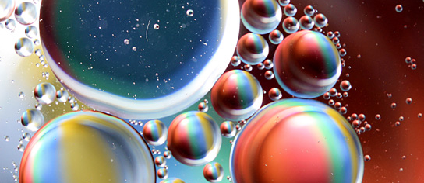
An example of mixing a polar compound with a nonpolar compound
Oil and water do not mix. As this macro image of oil and water shows, oil does not dissolve in water but forms droplets instead. This is due to it being a nonpolar compound.

Slide 22
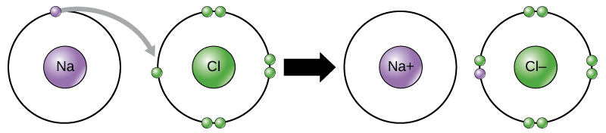
Ionic Bonds - Atoms give up or gain electrons
In the formation of an ionic compound, metals lose electrons and nonmetals gain electrons to achieve an octet.

Slide 23
Hydrogen bonds and
Van der Waals interactions
Ionic and Covalent bonds – require energy to break
Weaker bonds
Hydrogen bonds – interaction between the δ⁺ of hydrogen and the δ⁻ of a more electronegative atom on another molecule – often occurs between water molecules
Van der Waals interactions – weak attractions or interactions between two or more molecules (in close proximity) due to changes in electron density
https://youtu.be/OoYeIsSkafI

